Slide 1
Application development
Sw601f12-PARROT

Slide 2
Multi Project
Multi project
Target group
Guardians
Children with ASD
Development method
Agile and scrum
Our development method.

Slide 3
Multi Project cont.
Problem definition
How can we ease the daily life for children with ASD and their guardians, while complying with the study regulation?

Slide 4
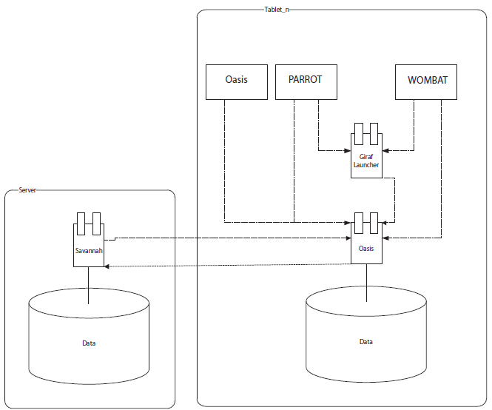
Multi Project cont.
System description & architecture.

Slide 5
Analysis
Meeting with Tove

Slide 6
Application Design
Design Choices
Feature choices

Slide 7
Implementation
Features/functions
Functional GUI
Pictograms: Viewing and Playing
Catagories: Creation and Customization
Color Customization

Slide 8
Features we Want
Getting PARROT Fully Integrated into Giraf
Adding Pictograms Proper
More Options and a way to access them easily
Sub Categories.

Slide 9
Testing
Ad-hoc testing
Quality improvement on the run.
Dynamic Black box testing
Quality assurance according to the specification.
Usability testing

Slide 10
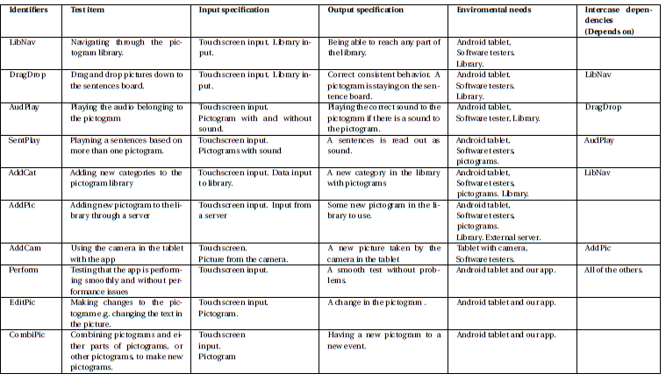
Dynamic Black box testing
Quality assurance according to the specification.

Slide 11
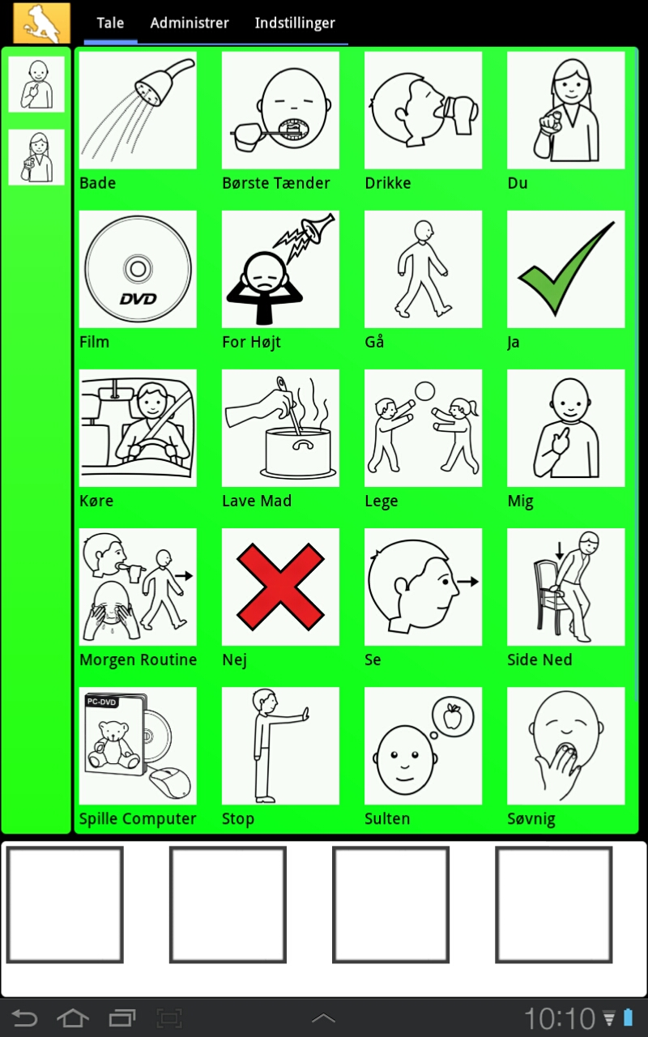

Slide 12
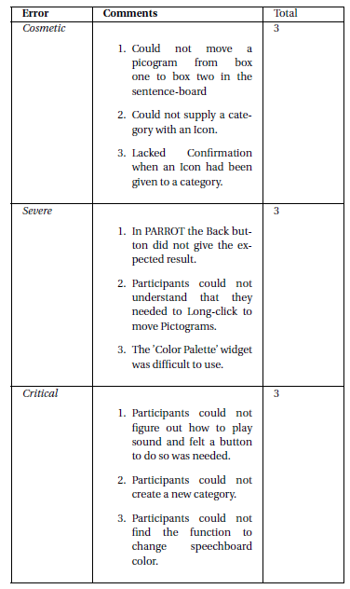
Usability testing

Slide 13
Epilog

